Slide 1
Movies on Netflix

Slide 2




TABLE OF CONTENTS
01
02
Purpose of Project
Methodology
03
04
Findings
Conclusion
01
02
03
04

Slide 3
Purpose of this Project
01
The aim of this project is to analyse the movies on Netflix.
We would be interested to find out any correlations between the movies/TV shows that are most popular and see any trends such as running time
Other interesting data to analyse would be to languages, genres, directors, actors, and the time run of the movies.

Slide 4




Methodology: Technologies and Libraries
Flask
SQLite
WebScraping
JavaScript
Pandas
02
D3
Plotly
Anychart
Notes:
D3
Plotly

Slide 5
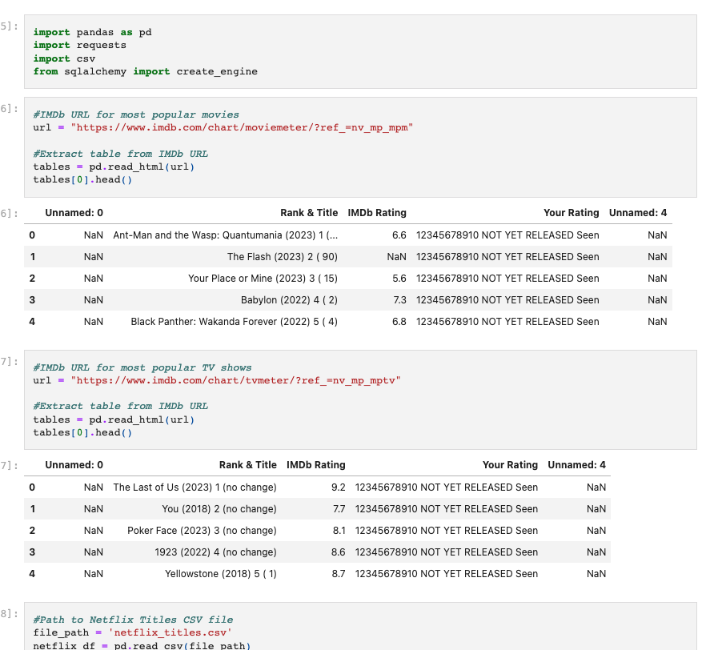
Methodology: Data Sources
02
Data is derived via a CSV download from Kaggle (https://www.kaggle.com/), and via API from OMDb (https://www.omdbapi.com/).
There are 2 different endpoints used to collect the data.
1. Years
2. Ratings
Data ranges from the past two decades, and over 5000 titles across Movies and TV shows.
We chose this dataset because we originally wanted to compare Netflix and Amazon, however we didn’t get the opportunity to do so.
Also Kareem is a big movie fan!

Slide 6
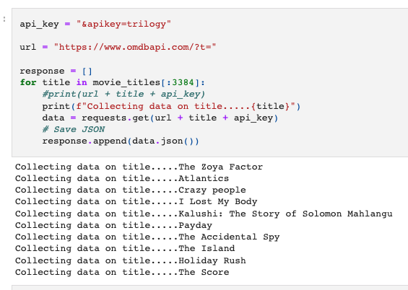
Methodology: Data Extraction and Transformation
02
Perform the Extract, Transform and Load (ETL) process to create a data pipeline on the Netflix movie datasets using Python, Pandas, Jupyter Notebook and QL.
We then created automated pipeline that takes in new data, performs the appropriate transformations, and loads the data into existing tables.
Refactored the code and created one function that takes in the datas —and performs the ETL process by adding the data to a PostgreSQL database.
It transforms and merges the data and loads it into an updatable SQL dataset tables ready to be used for the following analysis.

Slide 7
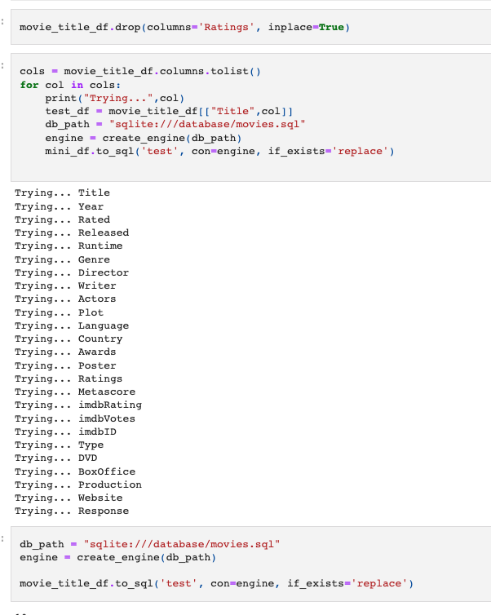
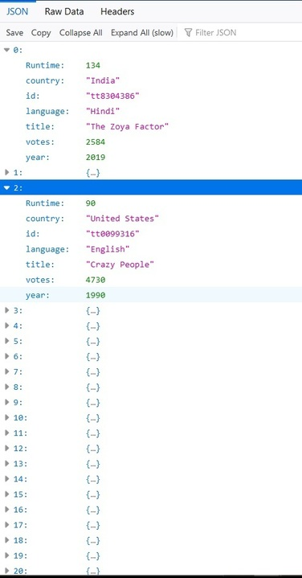
Methodology: Data Loading and Data Visualisation
02
5. We used SQLite to load this into the Flask, to then translate into HTML.
6.The engine was created to connect this to the database, we used used JavaScript and D3 to grab the API into the JavaScript.
7. To create the visualisation we used plotly.
We wanted to aim for visualisations that show runtimes via country and years to compare cultural differences and how Netflix caters to these.
We then wanted to show ratings of the movies by country to see how different countries appreciate different genres etc.

Slide 8
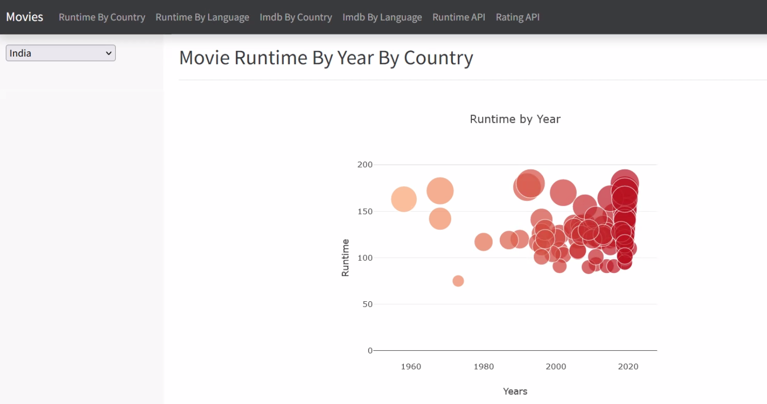
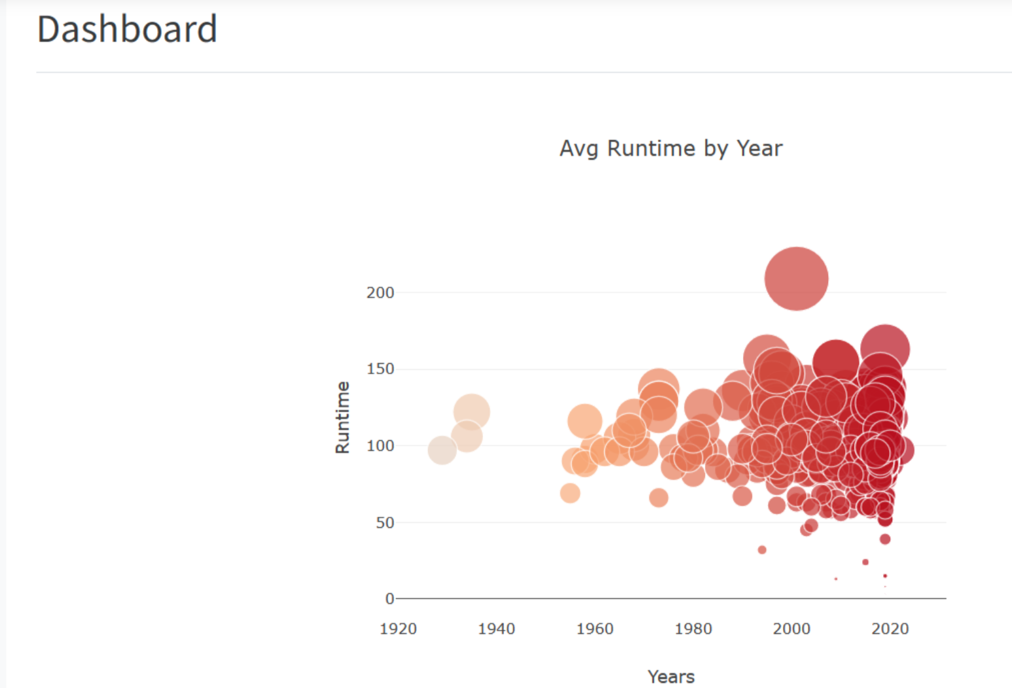
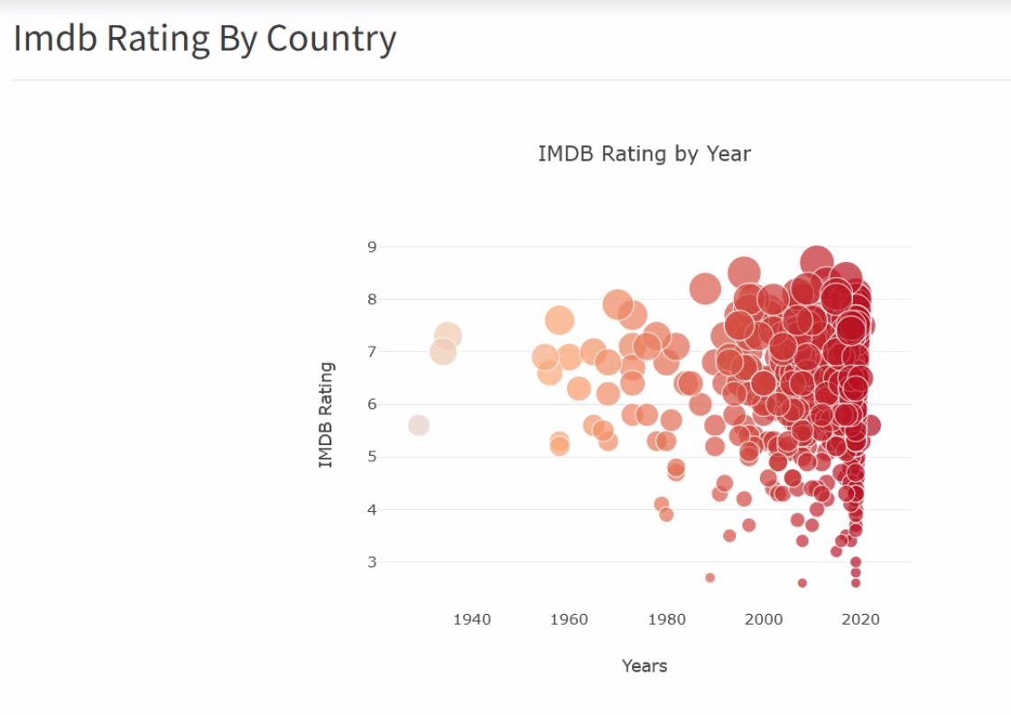
Results
03
Every year there are more rating available.
On Netflix there is am even distribution of movie ratings.
Netflix tends to drop lower rating movies from its platform and retain high rated films. This is represented by the density in the top right
80%
On average a movie run time is 120 mins and has been consistent throughout the years for the US
50%

Slide 9

Challenges and Conclusion
04
Challenges:
Using Json and HTML
- Try to understand technologies better and explore other libraries
2. Time management
- Have more structure
3. The topic we chose, it was hard to ”tell a story” from the dataset we were working
Conclusion

Slide 10
The TEAM
TONY
KAREEM
ELIYZA
JADE

